Slide 1
Data Preprocessing
Week 2

Slide 2
Definition
Data Pre-processing is a key step in Knowledge Discovery in Databases (KDD) that prepares raw data for effective data mining.
Han, J., Kamber, M., & Pei, J. (2012)

Slide 3
Objectives
- Improve data quality
- Reduce noise and inconsistencies
- Prepare data for mining algorithms
- Enhance model accuracy

Slide 4
Common Techniques
- Data cleaning
- Handling missing values
- Noise removal
- Outlier detection

Slide 5
Data Quality
A well-accepted multidimensional view of data quality:
  Accuracy
  Completeness
  Consistency
  Timeliness
  Believability
  Interpretability
  Accessibility

Slide 6
Major tasks in data pre-processing
Data cleaning
Fill in missing values, smooth noisy data, identify or remove outliers, and resolve inconsistencies
Data integration (if needed)
Integration of multiple databases, data cubes, or files
Data transformation
Normalization and aggregation
Data reduction
Obtains reduced representation in volume but produces the same or similar analytical results
Data discretization
particular importance for numerical data;
reduces the number of values of attributes
Often transform quantitative data into qualitative

Slide 7
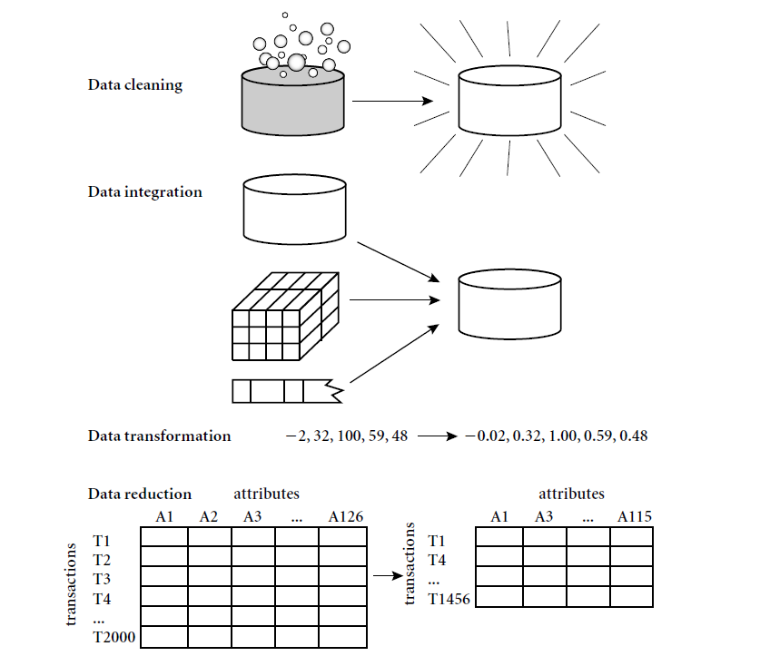
Forms of data pre-processing

Slide 8
Data Cleaning
Data cleaning tasks
  Fill in missing values
  Identify outliers and smooth out noisy data
  Correct inconsistent data

Slide 9
Missing Data
Data is not always available
Missing data may be due to
  equipment malfunction
  inconsistent with other recorded data and thus deleted
  data not entered due to misunderstanding
  certain data may not be considered important at the time of entry
  not register history or changes of the data
Missing data may need to be inferred.

Slide 10
Data Cleaning
Data in the Real World Is Dirty: Lots of potentially incorrect data, e.g., instrument faulty, human or computer error, transmission error
  incomplete: lacking attribute values, lacking certain attributes of interest, or containing only aggregate data
    e.g., Occupation=“ ” (missing data)
  noisy: containing noise, errors, or outliers
    e.g., Salary=“−10” (an error)
  inconsistent: containing discrepancies in codes or names, e.g.,
    Age=“42”, Birthday=“03/07/2010”
    Was rating “1, 2, 3”, now rating “A, B, C”
    discrepancy between duplicate records
  Intentional (e.g., disguised missing data)
    Jan. 1 as everyone’s birthday?

Slide 11
Incomplete (Missing) Data
Data is not always available
  E.g., many tuples have no recorded value for several attributes, such as customer income in sales data
Missing data may be due to
  equipment malfunction
  inconsistent with other recorded data and thus deleted
  data not entered due to misunderstanding
  certain data may not be considered important at the time of entry
  not register history or changes of the data
Missing data may need to be inferred

Slide 12
How to Handle Missing Data?
Ignore the tuple: usually done when class label is missing (when doing classification)—not effective when the % of missing values per attribute varies considerably
Fill in the missing value manually: tedious + infeasible?
Fill in it automatically with
  a global constant : e.g., “unknown”, a new class?!
  the attribute mean
  the attribute mean for all samples belonging to the same class: smarter
  the most probable value: inference-based such as Bayesian formula or decision tree

Slide 13
Noisy Data
Noise: random error or variance in a measured variable
Incorrect attribute values may be due to
  faulty data collection instruments
  data entry problems
  data transmission problems
  technology limitation
  inconsistency in naming convention
Other data problems which require data cleaning
  duplicate records
  incomplete data
  inconsistent data
13
Notes:
13

Slide 14
How to Handle Noisy Data?
Binning
  first sort data and partition into (equal-frequency) bins
  then one can smooth by bin means, smooth by bin median, smooth by bin boundaries, etc.
Regression
  smooth by fitting the data into regression functions
Clustering
  detect and remove outliers
Combined computer and human inspection
  detect suspicious values and check by human (e.g., deal with possible outliers)

Slide 15
Data Integration
Data integration:
  Combines data from multiple sources into a coherent store
Schema integration: e.g., A.cust-id ≡ B.cust-#
  Integrate metadata from different sources
Entity identification problem:
  Identify real world entities from multiple data sources, e.g., Bill Clinton = William Clinton
Detecting and resolving data value conflicts
  For the same real world entity, attribute values from different sources are different
  Possible reasons: different representations, different scales, e.g., metric vs. British units
15

Slide 16
Handling Redundancy in Data Integration
Redundant data occur often when integration of multiple databases
  Object identification: The same attribute or object may have different names in different databases
  Derivable data: One attribute may be a “derived” attribute in another table, e.g., annual revenue
Redundant attributes may be able to be detected by correlation analysis and covariance analysis
Careful integration of the data from multiple sources may help reduce/avoid redundancies and inconsistencies and improve mining speed and quality
16

Slide 17
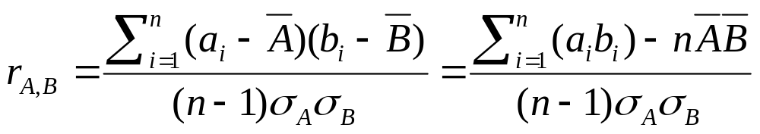


Correlation Analysis (Numeric Data)
Correlation coefficient (also called Pearson’s product moment coefficient)
  where n is the number of tuples, and are the respective means of A and B, σ_{A} and σ_{B} are the respective standard deviation of A and B, and Σ(a_{i}b_{i}) is the sum of the AB cross-product.
If r_{A,B} > 0, A and B are positively correlated (A’s values increase as B’s). The higher, the stronger correlation.
r_{A,B} = 0: independent; r_{AB} < 0: negatively correlated

Slide 18
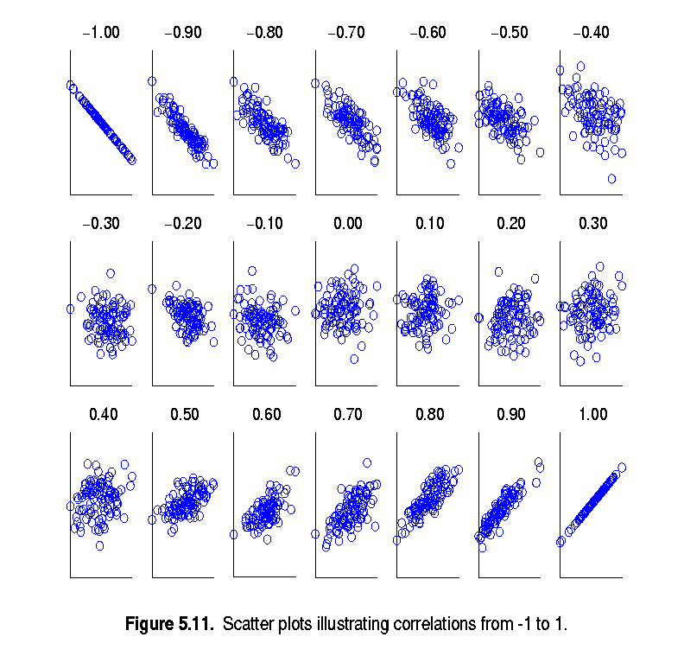
Visually Evaluating Correlation
Scatter plots showing the similarity from –1 to 1.

Slide 19
Data Reduction

Slide 20
Data Reduction
Overview
The Curse of Dimensionality
Data Sampling
Binning and Reduction of Cardinality

Slide 21
Overview
Data reduction techniques can be applied to achieve a reduced representation of the data set.
The goal is to provide the mining process with a mechanism to produce the same (or almost the same) outcome when it is applied over reduced data instead of the original data.

Slide 22
Overview
Data Reduction techniques are usually categorized into three main families:
  Dimensionality Reduction: ensures the reduction of the number of attributes or random variables in the data set.
  Sample Numerosity Reduction: replaces the original data by an alternative smaller data representation
  Cardinality Reduction: transformations applied to obtain a reduced representation of the original data

Slide 23
The Curse of Dimensionality
Dimensionality becomes a serious obstacle for the efficiency of most of the DM algorithms.
It has been estimated that as the number of dimensions increase, the sample size needs to increase exponentially in order to have an effective estimate of multivariate densities.

Slide 24
The Curse of Dimensionality
Several dimension reducers have been developed over the years.
Linear methods:
  Factor analysis
  MultiDimensional Scaling
  Principal Components Analysis
Nonlinear methods:
  Locally Linear Embedding
  ISOMAP

Slide 25
The Curse of Dimensionality: Principal Components Analysis
Find a set of linear transformations of the original variables which could describe most of the variance using a relatively fewer number of variables.
It is usual to keep only the first few principal components that may contain 95% or more of the variance of the original data set.
PCA is useful when there are too many independent variables and they show high correlation.

Slide 26
The Curse of Dimensionality: Principal Components Analysis
Procedure:
  Normalize input data.
  Compute k orthonormal vectors (principal components).
  Sort the PCs according to their strength, given by their eigenvalues.
  Reduce data by removing weaker components.

Slide 27
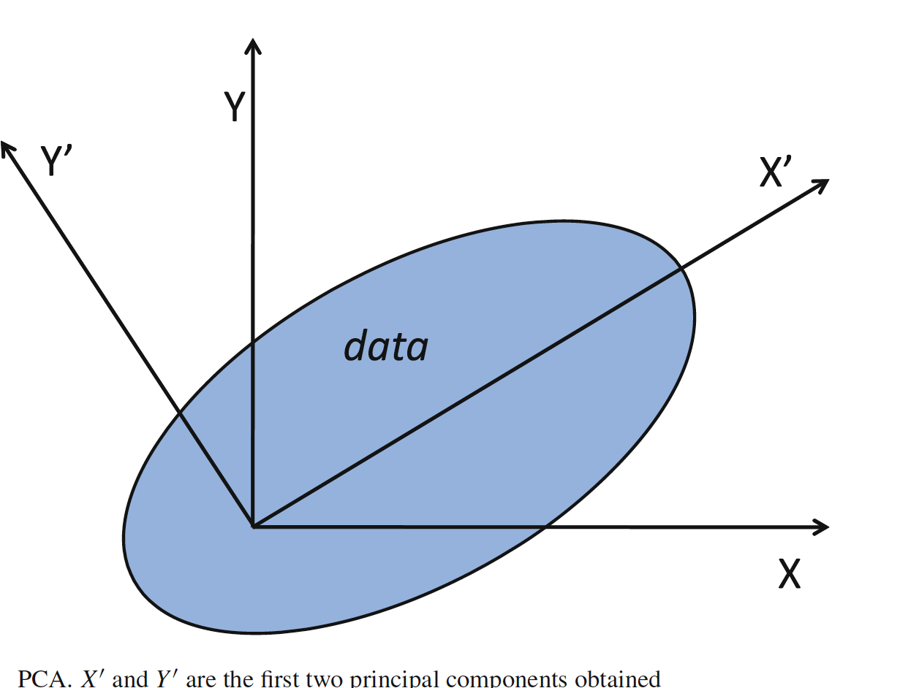
The Curse of Dimensionality: Principal Components Analysis

Slide 28
Data Sampling
To reduce the number of instances submitted to the DM algorithm.
To support the selection of only those cases in which the response is relatively homogeneous.
To assist regarding the balance of data and occurrence of rare events.
To divide a data set into three data sets to carry out the subsequent analysis of DM algorithms.

Slide 29
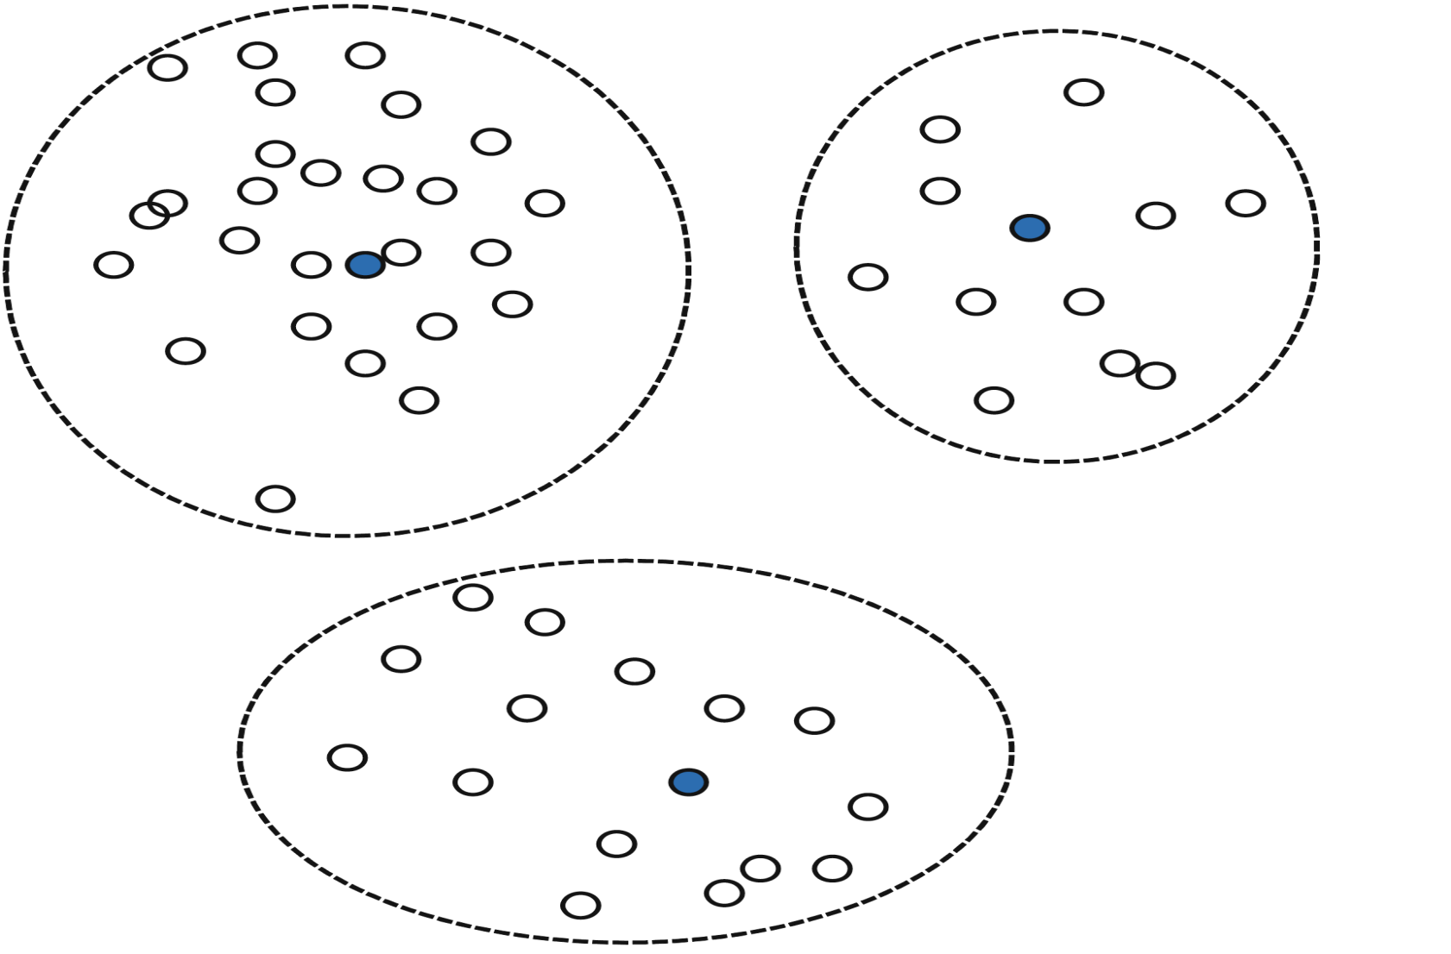
Data Sampling:
Data Clustering

Slide 30
Exercise
Scenario : Categorical Data
A dataset contains a column “Department” with values: Sales, HR, IT, Marketing.
Questions:
How would you preprocess this categorical feature for use in a machine learning model? Explain your choice.
What issues could arise if you assign arbitrary numeric values to the categories?
How could your preprocessing decision affect model interpretability and accuracy?

Slide 31
Data Transformation
A function that maps the entire set of values of a given attribute to a new set of replacement values s.t. each old value can be identified with one of the new values
Methods
  Smoothing: Remove noise from data
  Attribute/feature construction
    New attributes constructed from the given ones
  Aggregation: Summarization, data cube construction
  Normalization: Scaled to fall within a smaller, specified range
    min-max normalization
    z-score normalization
    normalization by decimal scaling
  Discretization: Concept hierarchy climbing
Notes:
31

Slide 32
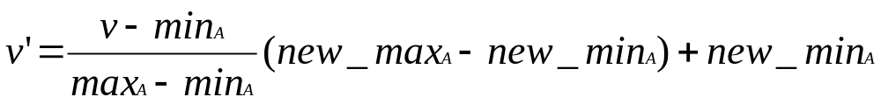
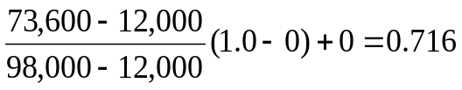
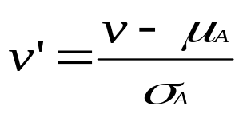
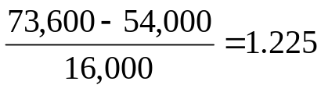
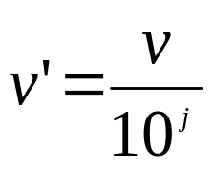
Normalization
Min-max normalization: to [new_min_{A}, new_max_{A}]
  Ex. Let income range $12,000 to $98,000 normalized to [0.0, 1.0]. Then $73,000 is mapped to
Z-score normalization (μ: mean, σ: standard deviation):
  Ex. Let μ = 54,000, σ = 16,000. Then
Normalization by decimal scaling
Where j is the smallest integer such that Max(|ν’|) < 1

Slide 33
Discretization
Three types of attributes
  Nominal—values from an unordered set, e.g., color, profession
  Ordinal—values from an ordered set, e.g., military or academic rank
  Numeric—real numbers, e.g., integer or real numbers
Discretization: Divide the range of a continuous attribute into intervals
  Interval labels can then be used to replace actual data values
  Reduce data size by discretization
  Supervised vs. unsupervised
  Split (top-down) vs. merge (bottom-up)
  Discretization can be performed recursively on an attribute
  Prepare for further analysis, e.g., classification

Slide 34
Data Discretization Methods
Typical methods: All the methods can be applied recursively
  Binning
    Top-down split, unsupervised
  Histogram analysis
    Top-down split, unsupervised
  Clustering analysis (unsupervised, top-down split or bottom-up merge)
  Decision-tree analysis (supervised, top-down split)
  Correlation (e.g., χ²) analysis (unsupervised, bottom-up merge)
34
Notes:
34

Slide 35
Exercise
Scenario : Imbalanced Dataset
You are working with a fraud detection dataset where 95% of transactions are legitimate and 5% are fraudulent.
Questions:
What preprocessing steps would you take to handle the class imbalance?
How would imbalance affect model training if not addressed?
What techniques could be used to mitigate imbalance, and what are their trade-offs?

Slide 36
References
D. P. Ballou and G. K. Tayi. Enhancing data quality in data warehouse environments. Comm. of ACM, 42:73-78, 1999
Han, Kamber & Pei, Data Mining: Concepts and Techniques (2012)
A. Bruce, D. Donoho, and H.-Y. Gao. Wavelet analysis. IEEE Spectrum, Oct 1996
T. Dasu and T. Johnson. Exploratory Data Mining and Data Cleaning. John Wiley, 2003
J. Devore and R. Peck. Statistics: The Exploration and Analysis of Data. Duxbury Press, 1997.

